Slide 1
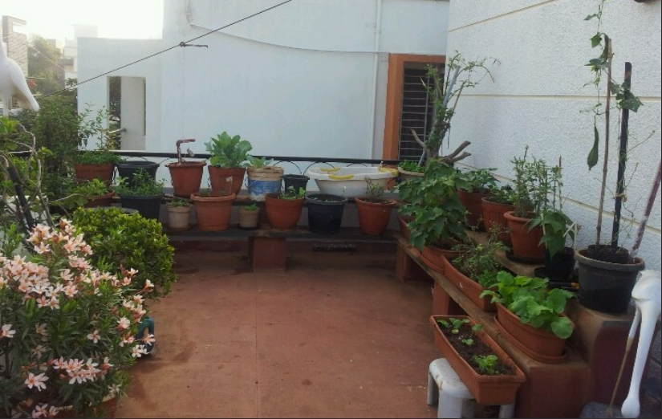
Smart Irrigation system using
Moisture Sensor and Robotic Arm
(for house garden)
Team : Brain Clusters
[Ujjawal Kumar{leader}, Vaibhav Chaudhary, Hrishabh Kumar Saini, Om Kumar Rakshit, Mohit Chandra]

Slide 2
Introduction
In absence of residents at home, we need an irrigation system to water the plants at the correct time so that the plants are well irrigated at all times.
For this we need to make the irrigation system “smart”.

Slide 3
Components Required
Arduino UNO Board
Principle: You can tell your board what to do by sending a set of instructions to the microcontroller on the board.
Use: Taking input from the moisture sensor and providing instructions to DC motor.

Slide 4
Small Breadboard
Principle: Designed to work with through-hole electronic components.
Use: To form simple electrical connections among different components.
Servo motor
Principle: Servo motor works on PWM (Pulse Width Modulation) principle, means its angle of rotation is controlled by the duration of applied pulse to its control PIN.
Use: Used in the robotic arm in our project.

Slide 5
DC Motor
Principle: Operates on Faraday’s principle of electromagnetism which states that a current carrying conductor experiences a force when placed in a magnetic field.
Use: To pump the water up.
Moisture sensor
Principle: Uses capacitance to measure dielectric permittivity of the surrounding medium.
Use: To sense the moisture content of the soil.

Slide 6
COST :-
Rs. 2400

Slide 7
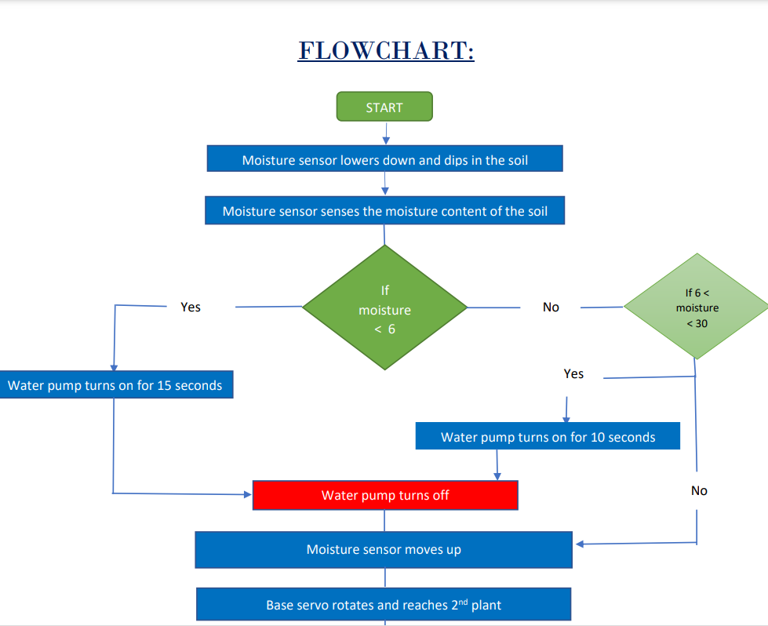

Slide 8
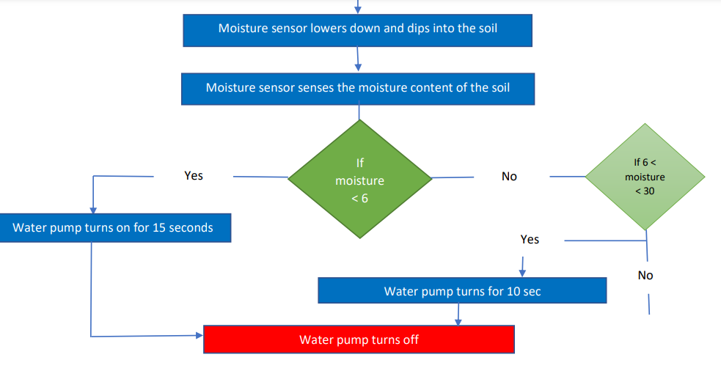

Slide 9
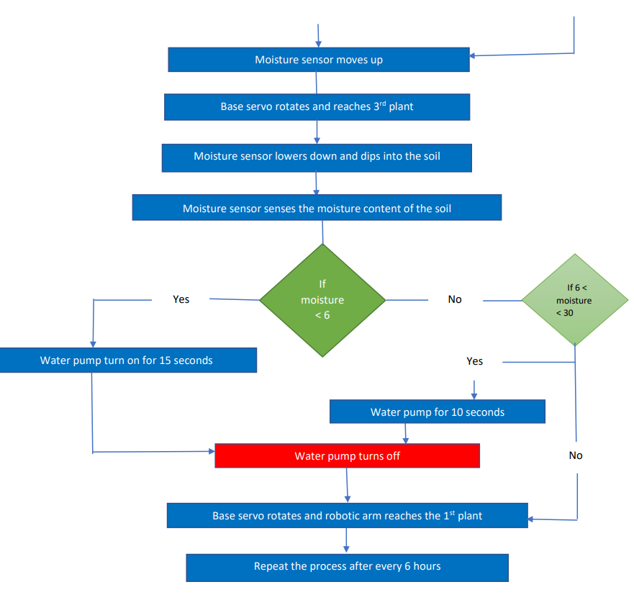

Slide 10
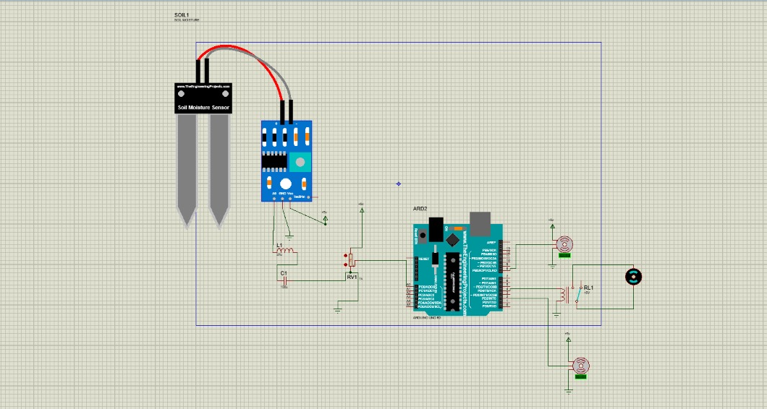
MODEL OF ELECTRICAL CIRCUIT

Slide 11
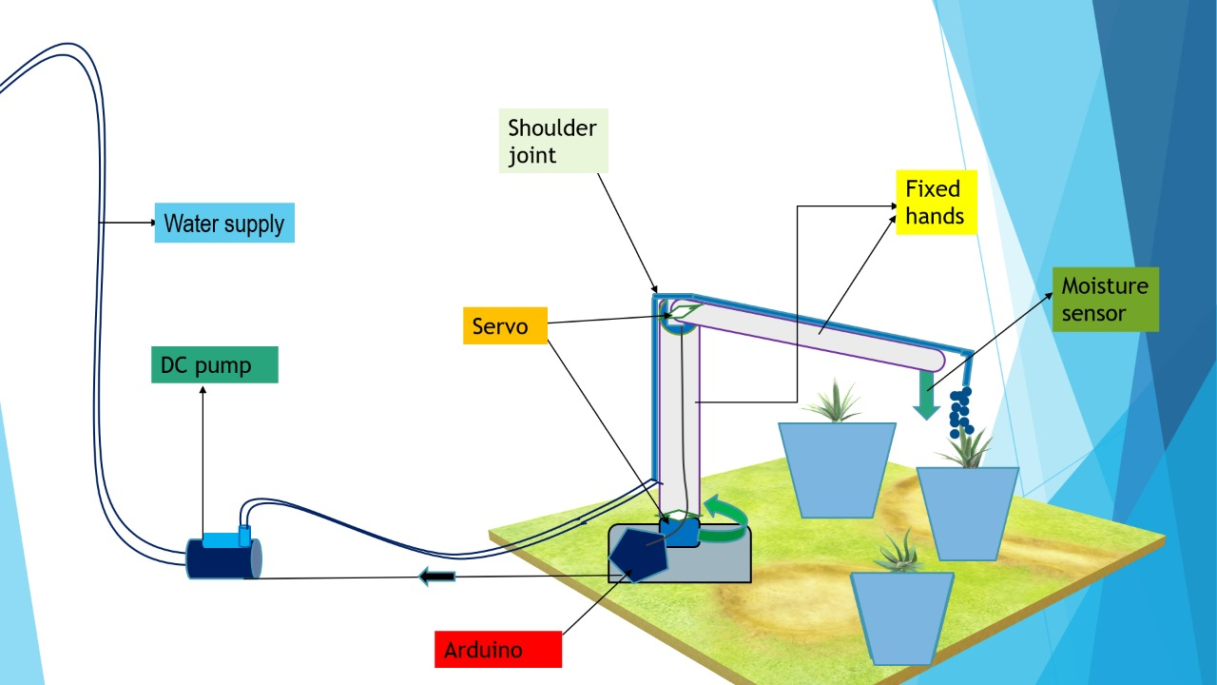

Slide 12
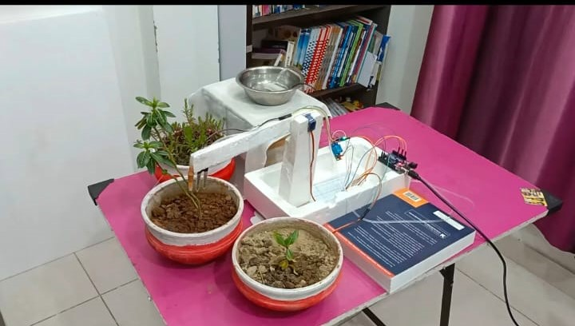

Slide 13
Working
Our model consists of 2 major parts:
1. The moisture sensor attached to the robotic arm.
2. And the water pump. After switching on the system, the robotic arm lowers down and the moisture sensor dips into the soil and measures the moisture content.

Slide 14
The pump works such that,
• if the moisture content of plant is less than 6 then the water is pumped for 15 seconds.
• If the moisture content is less than 30 but greater than 6 then the water is pumped for 10 seconds.
• If the moisture content is greater than 30, then no water is pumped.
After plant 1, the arm moves to plant 2 and the same process continues and the same process is done for plant 3 as well. The process repeats after every 6 hours or as per convenience.

Slide 15
Division of work
Ujjawal Kumar : Coordination, Coding
Rishabh Kumar Saini : Video Editing, Circuit
Vaibhav Chaudhary : Research, Assemble
Om Kumar Rakshit : Report, Coding
Mohit Chandra : Presentation, Research

Slide 16
Challenges we have faced
1. Rotating water tap using servo motor.
2. Running water motor using Arduino ( Relay has been used later).

Slide 17
THANK YOU !

